Slide 1
Guide for Faculty Navigating R’Ability

Slide 2
R’Ability Website
Visit the R’Ability website at rability.ucr.edu
Select “Faculty Portal”

Slide 3
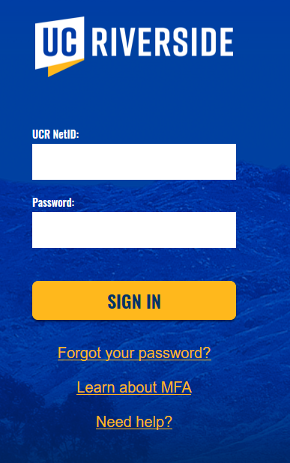
R’Ability Website
Login using the UCR credentials

Slide 4
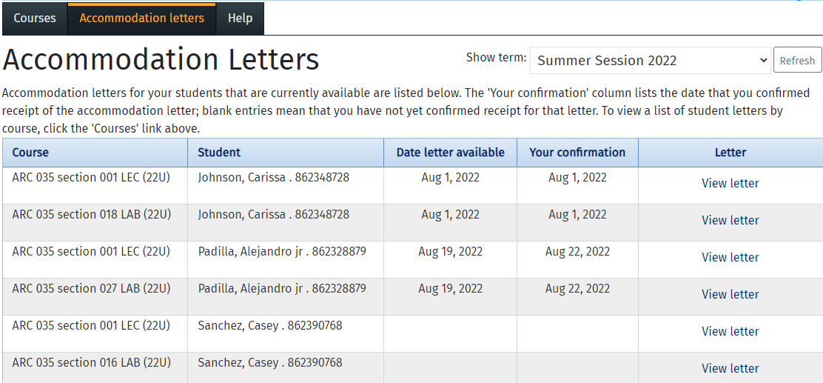
R’Ability Website
Select “Accommodation Letter”

Slide 5
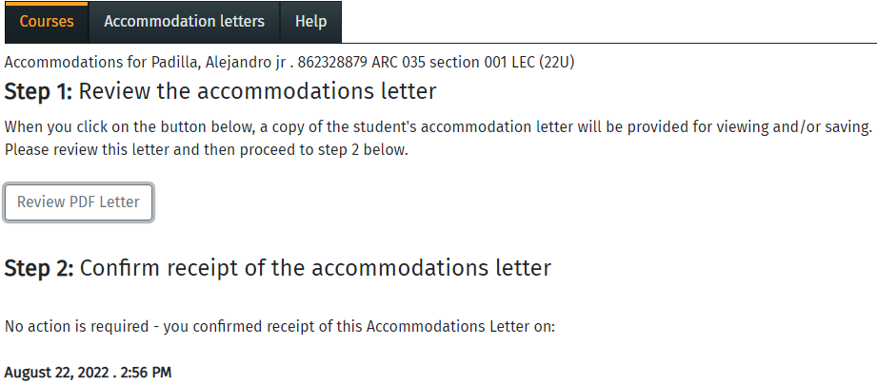
R’Ability Website
Select “Review PDF Letter”

Slide 6
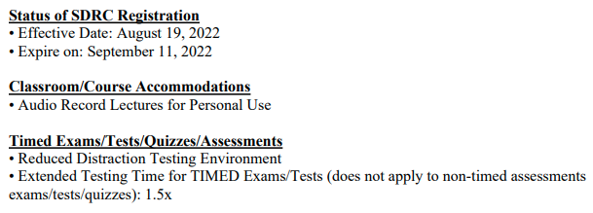
PDF Letter (Student Accommodations)
The PDF document will open up
You will be provided with the student name, SDRC-approved accommodations and pertinent information regarding accommodations

Slide 7
Thank you!
For additional information, please contact us:
Email: sdrc@ucr.edu | Call: 951-827-3861
Visit: Student Services Building, Room 1228

