Slide 1
Guide for Students: Scheduling Exams through R’Ability

Slide 2
Scheduling Exams through R’Ability

Slide 3
R’Ability Website
Visit the R’Ability website at rability.ucr.edu
Select “Students Portal”

Slide 4
Schedule a test or final exam
Select “Schedule a Test or Final Exam”

Slide 5
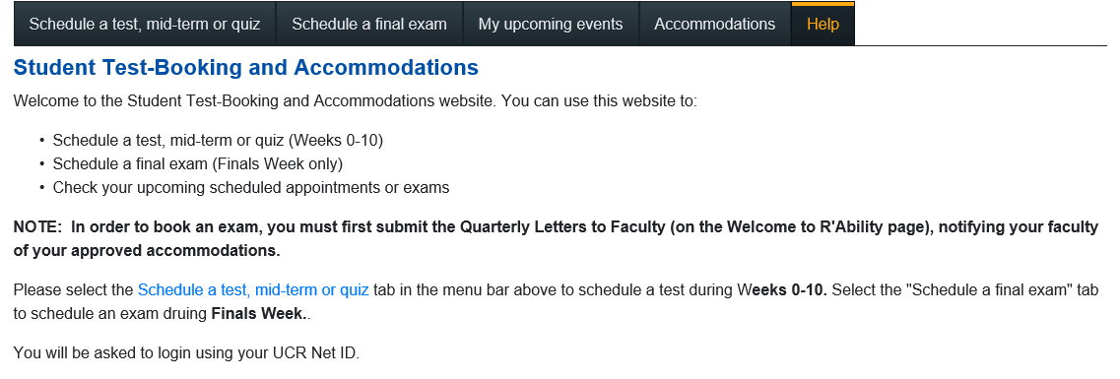
Test-Booking Accommodations
Select “Schedule a Test, mid-term or quiz” for all exam appointments during weeks 0-10 including the Saturday before finals week.
Select “Schedule a final exam” for all exam appointment during Finals Week (Monday through Friday).

Slide 6
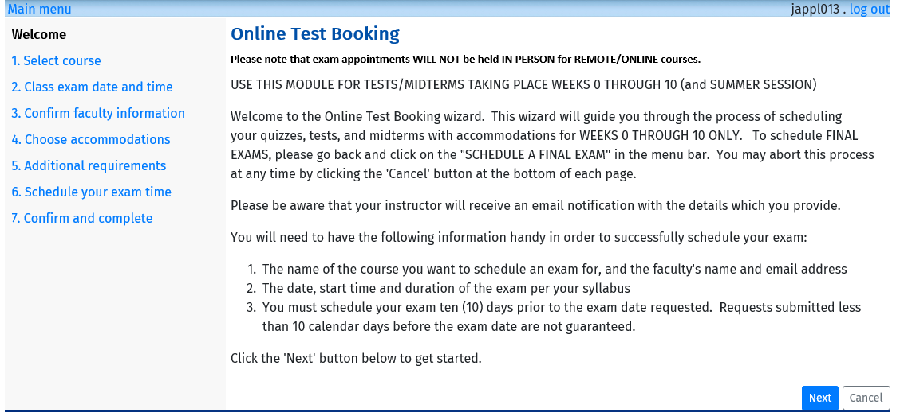
Online Test Booking
Please note: tests, midterms or quizzes must be scheduled 10 days prior to the exam date
Final exams must be scheduled 14 days prior to the exam date.
Select “Next” to get started

Slide 7
Select Course
Select the course for which you would like to schedule a test from the
drop-down menu.
Select “Next” to continue.

Slide 8
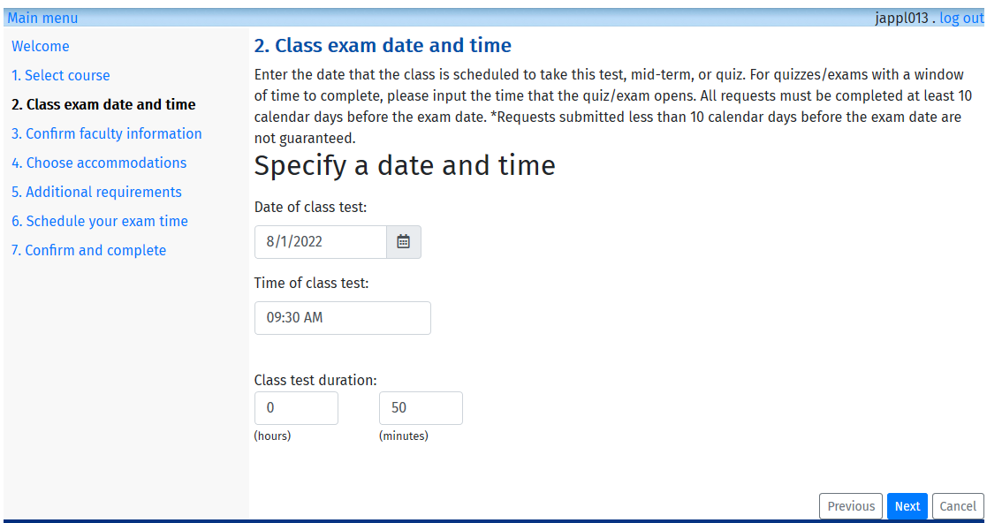
Class exam date and time
Enter the date and time that the class is taking the test.
Include the duration of the exam in class (extended time will be calculated by the system.
Select “Next” to continue.

Slide 9
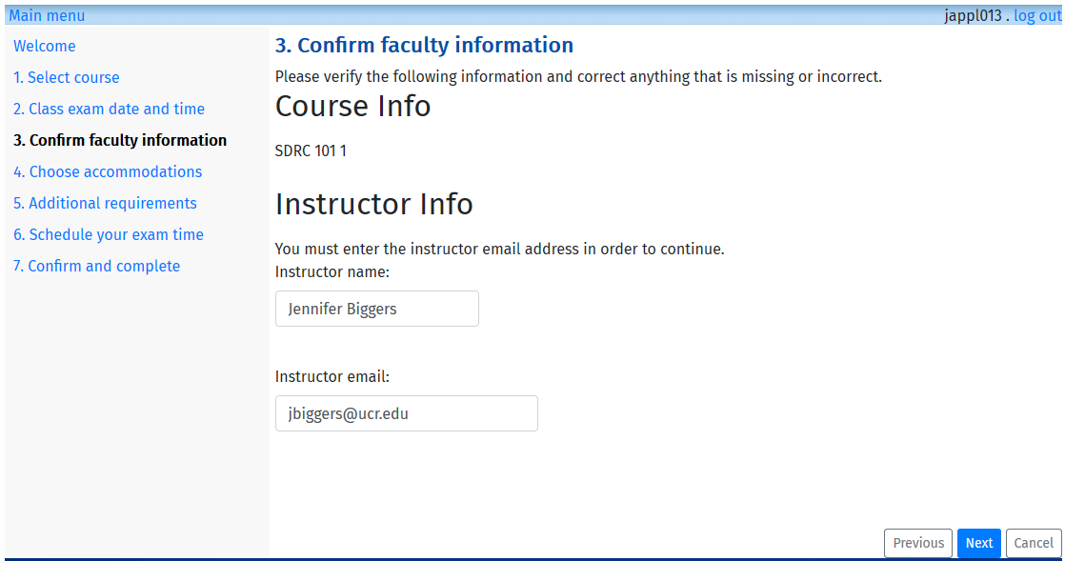
Confirm Faculty Information
Confirm Instructor Info: Name and Email
Select “Next” to continue

Slide 10
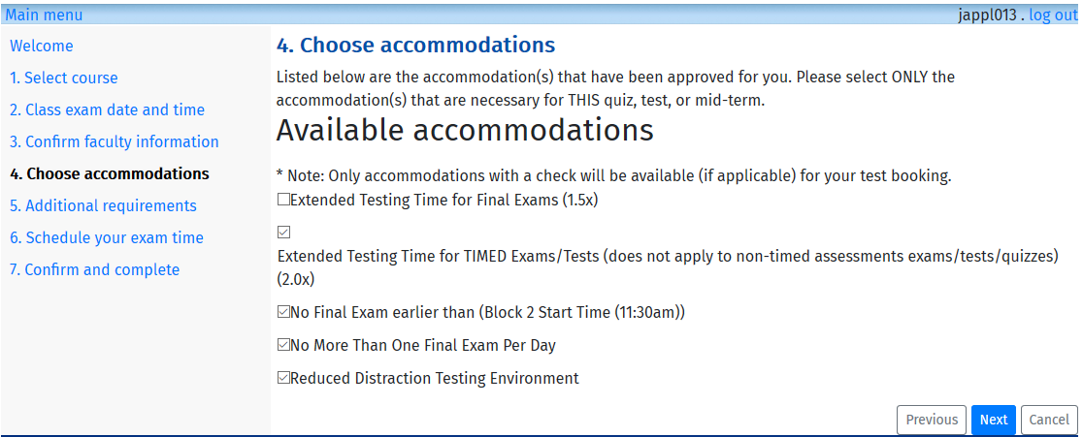
Choose Accommodations
Select “Accommodations” needed for the exam you are scheduling for
Select “Next” to continue

Slide 11
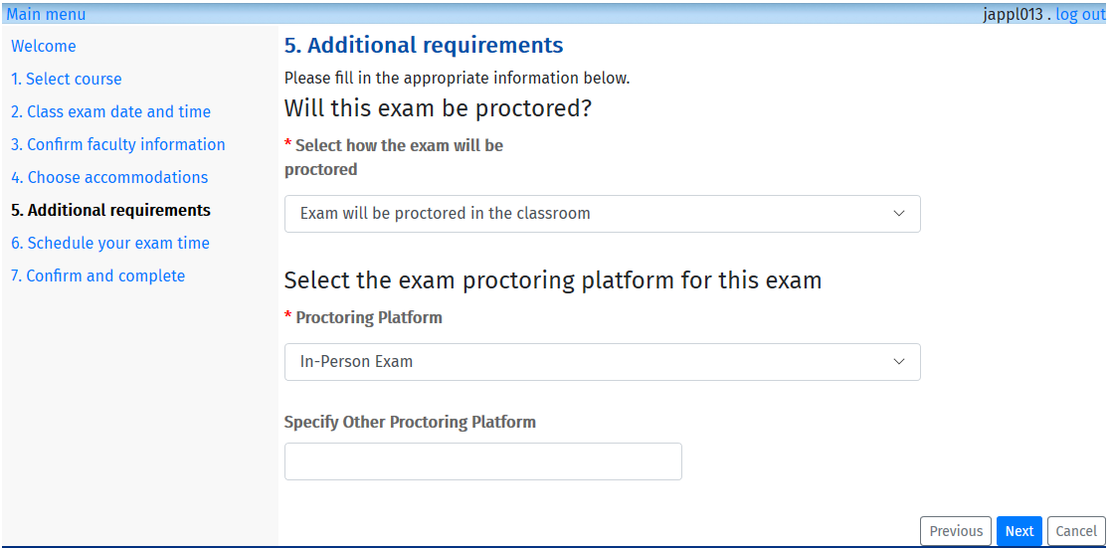
Additional Requirements
Select “How the exam will be proctored” and “Proctoring Platform”
Select “Next” to continue

Slide 12
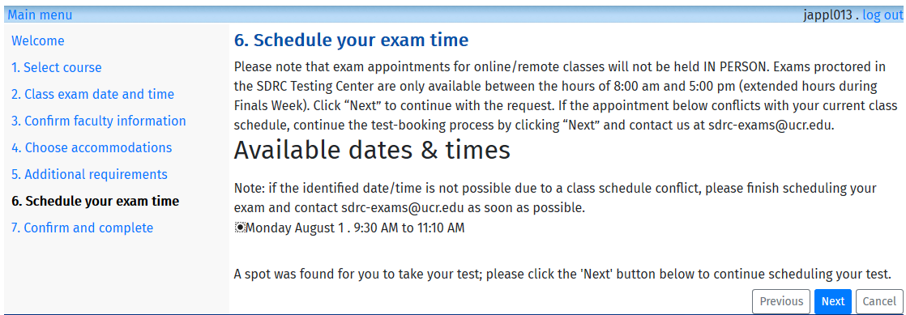
Schedule your exam time
Review the available dates and times listed are correct
Select “Next” to continue

Slide 13
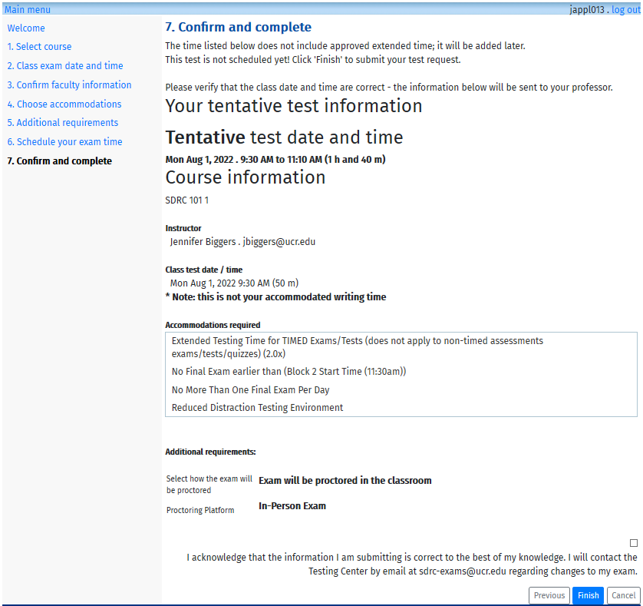
Confirm and Complete
Review the Test Information
Acknowledge that the test information is correct (select box)
Select “Next” to continue

Slide 14
My upcoming events
After you schedule your exam, you may view a list of the exams scheduled by selecting “My upcoming events”

Slide 15
Thank you!
For additional information, please contact us:
Email: sdrc@ucr.edu | Call: 951-827-3861
Visit: Student Services Building, Room 1228

