Slide 1
Guide for Faculty Navigating R’Ability
View/Download Accommodation Letters
Confirm/Edit exam information submitted by Student
Schedule Upcoming Tests (pro-active approach)

Slide 2
View/Download Accommodation Letters

Slide 3
R’Ability Website
Visit the R’Ability website at rability.ucr.edu
Select “Faculty Portal”

Slide 4
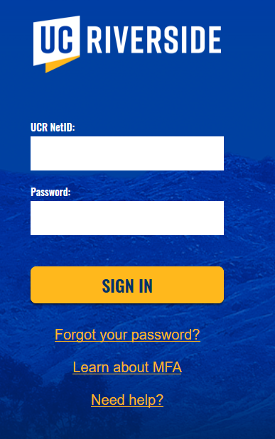
R’Ability Website
Login using the UCR credentials

Slide 5
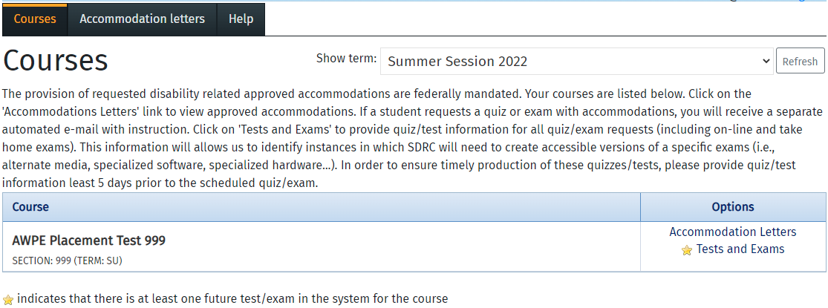
Accommodation Letters
Select “Accommodation Letters”

Slide 6
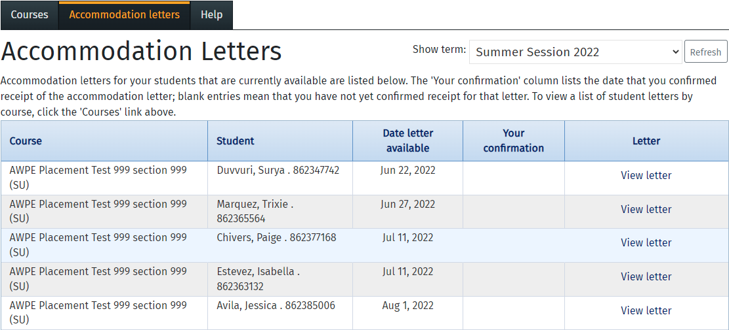
Accommodation Letters
If there are students enrolled in your class eligible for testing accommodations, you will see their name listed
Date Letter Available, is the date when the student sent the accommodation letter
Select “View Letter”
Student Name (Student ID)
Student Name (Student ID)
Student Name (Student ID)
Student Name (Student ID)
Student Name (Student ID)

Slide 7
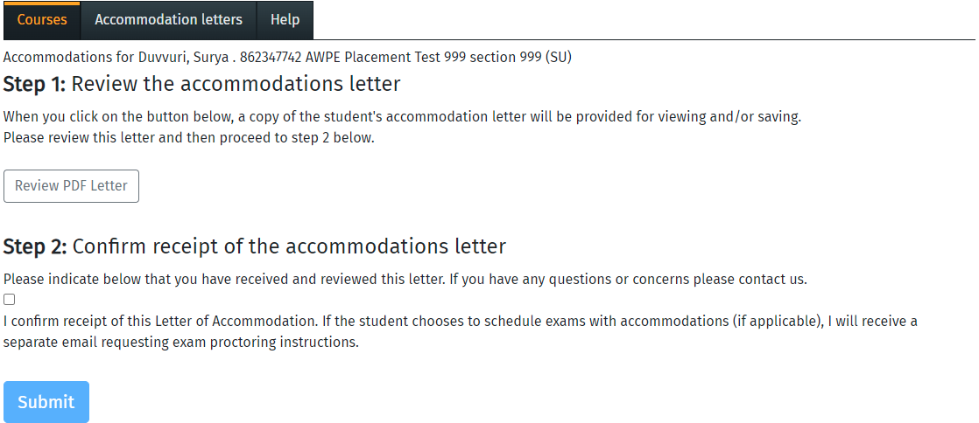
Reviewing the Letter
Review the accommodations letter (review PDF)
Confirm receipt of the accommodation letter (check the box to indicate that you reviewed the letter)
Select “Submit”

Slide 8
Confirm/Edit exam information submitted by Student

Slide 9
R’Ability Website
Visit the R’Ability website at rability.ucr.edu
Select “Faculty Portal”

Slide 10
R’Ability Website
Login using the UCR credentials

Slide 11
Courses
Select “Courses” under Options

Slide 12
Tests and Exams
Select “Tests and Exams” under Options

Slide 13
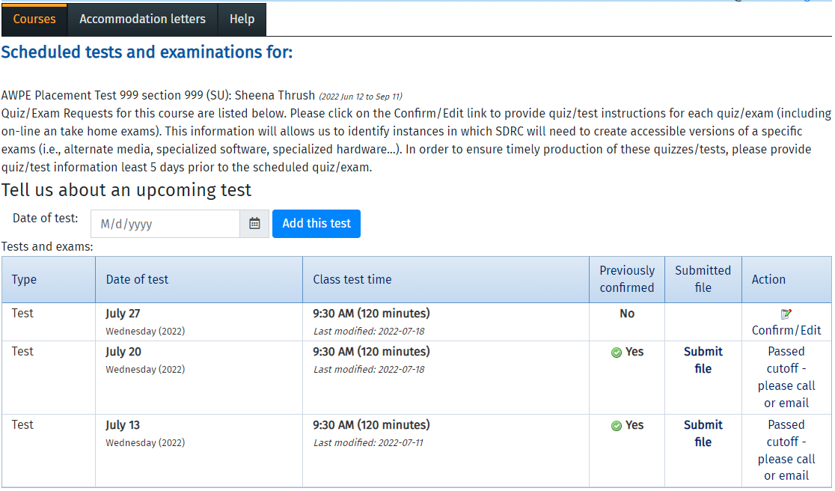
Scheduled tests and examinations for
Select “Confirm/Edit”

Slide 14
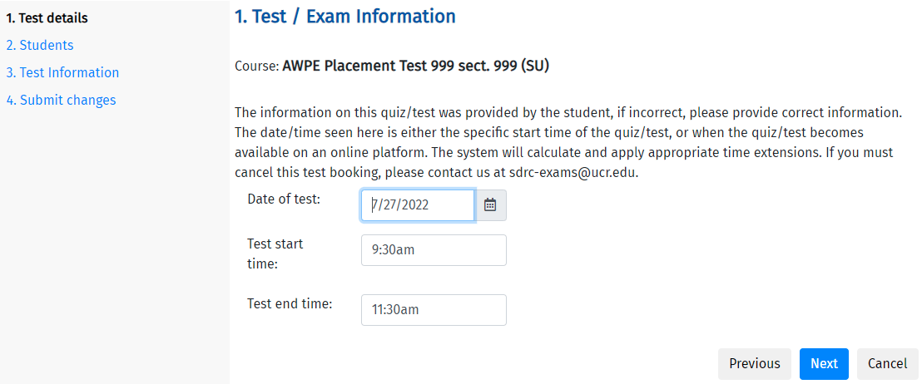
1. Test/Exam Information
Confirm that the Date of Test, Test Start Time and Test End Time are correct. If the information is incorrect, please make the necessary changes on this screen.
Select “Next”

Slide 15
2. Students scheduled to date for CLASS NAME
Review (date/time) the list of the students that have registered to take the quiz/text
Select “Next”
Student Name (Student ID)

Slide 16
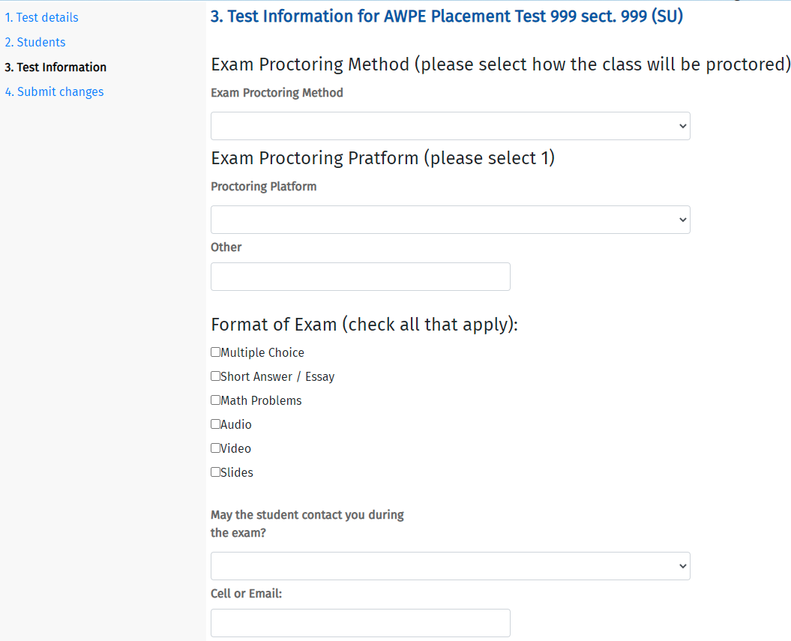
3. Test Information for CLASS NAME
Enter the Exam Proctoring Information
Continued…

Slide 17
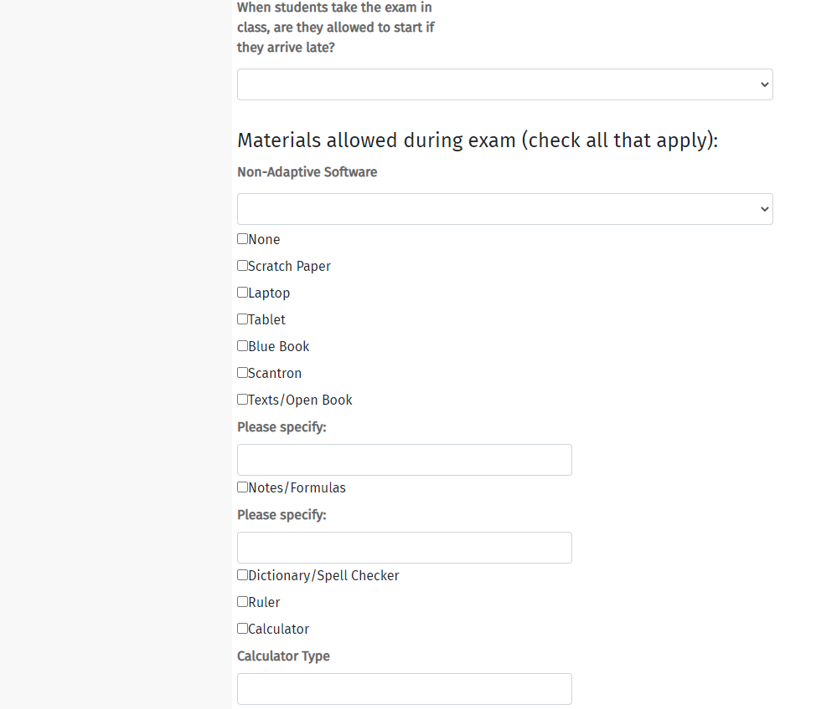
3. Test Information for CLASS NAME
Enter the Exam Proctoring Information
Continued..

Slide 18
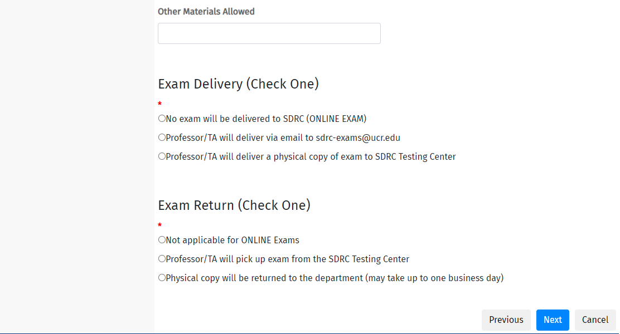
3. Test Information for CLASS NAME
Enter the Exam Proctoring Information
Select “Next”

Slide 19
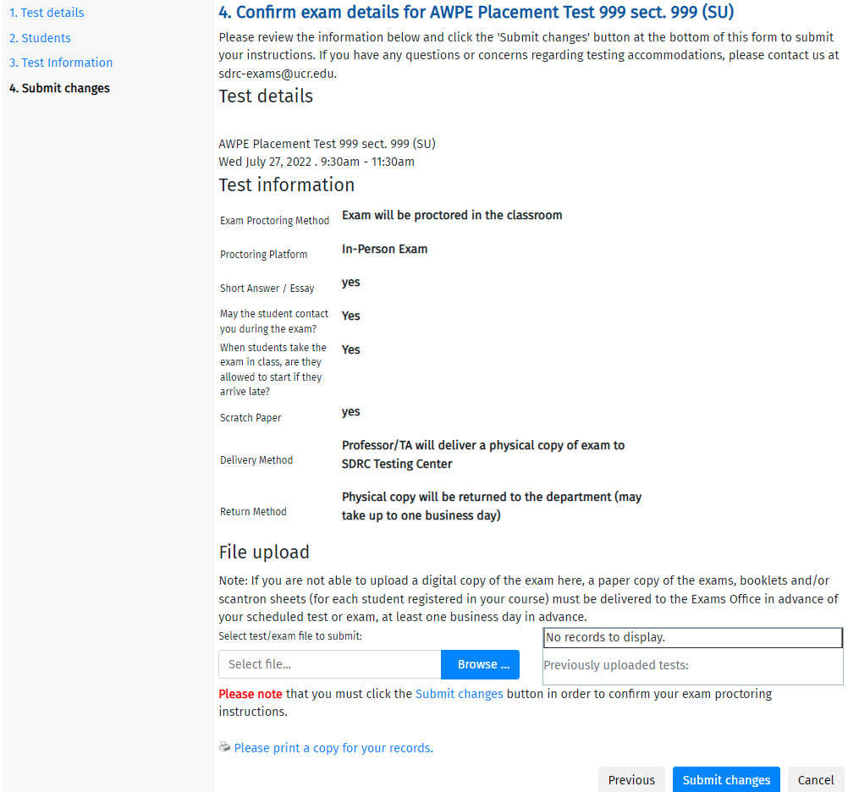
4. Confirm exam details for CLASS NAME
Review the Test Details and Test Information
Select “Submit Changes” to complete this process

Slide 20
Schedule Upcoming Tests (pro-active approach)

Slide 21
R’Ability Website
Visit the R’Ability website at rability.ucr.edu
Select “Faculty Portal”

Slide 22
R’Ability Website
Login using the UCR credentials

Slide 23
Courses
Select “Courses”

Slide 24
Tests and Exams
Select “Tests and Exams” under Options

Slide 25
Tell us about an upcoming test
Enter Date of Test
Select “Add this Test”

Slide 26
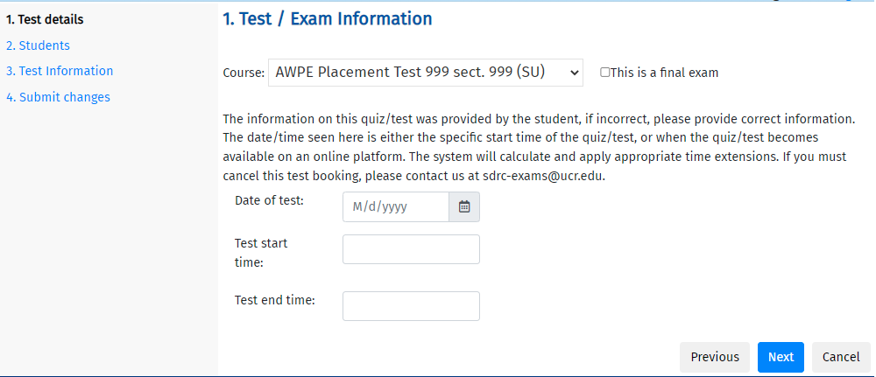
1. Test/Exam Information
Enter the Date of Test, Test Start Time and Test End Time
Select “Next”

Slide 27
2. Students scheduled to date for CLASS NAME
Review the list of the students that have registered to take the quiz/test. You may or may not see a list of students; this will depend if the student has informed SDRC that they plan to take the exam with testing accommodations.
Select “Next”
Student Name (Student ID)

Slide 28
3. Test Information for CLASS NAME
Enter the Exam Proctoring Information
Continued…

Slide 29
3. Test Information for CLASS NAME
Enter the Exam Proctoring Information
Continued..

Slide 30
3. Test Information for CLASS NAME
Enter the Exam Proctoring Information
Select “Next”

Slide 31
4. Confirm exam details for CLASS NAME
Review the Test Details and Test Information
Select “Submit Changes” to complete this process

Slide 32
Thank you!
For additional information, please contact us:
Email: sdrc@ucr.edu | Call: 951-827-3861
Visit: Student Services Building, Room 1228

