Slide 1
Guide for Students: Quarterly Accommodations Request

Slide 2
Sending quarterly accommodation letters to your instructors

Slide 3
R’Ability Website
Visit the R’Ability website at rability.ucr.edu
Select “Students Portal”

Slide 4
R’Ability
Select “Quarterly Letters to Faculty”

Slide 5
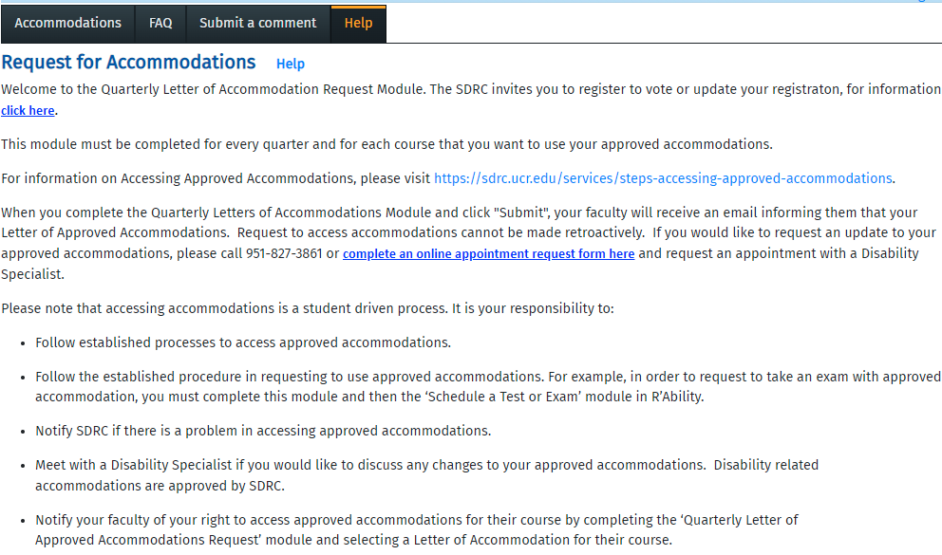
Request for Accommodations
Select “Accommodations”

Slide 6
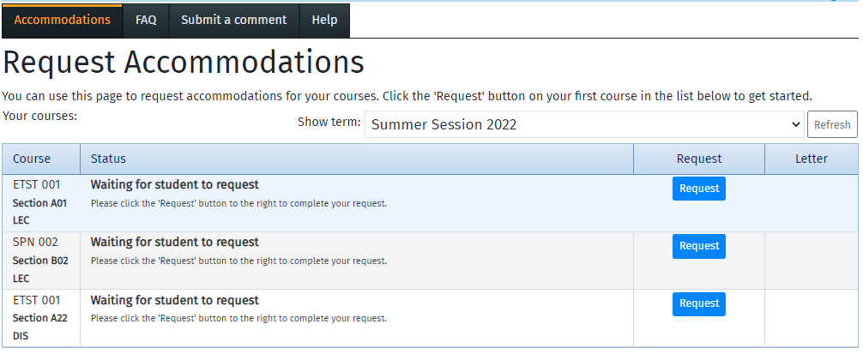
Request Accommodations
Select “Request”

Slide 7
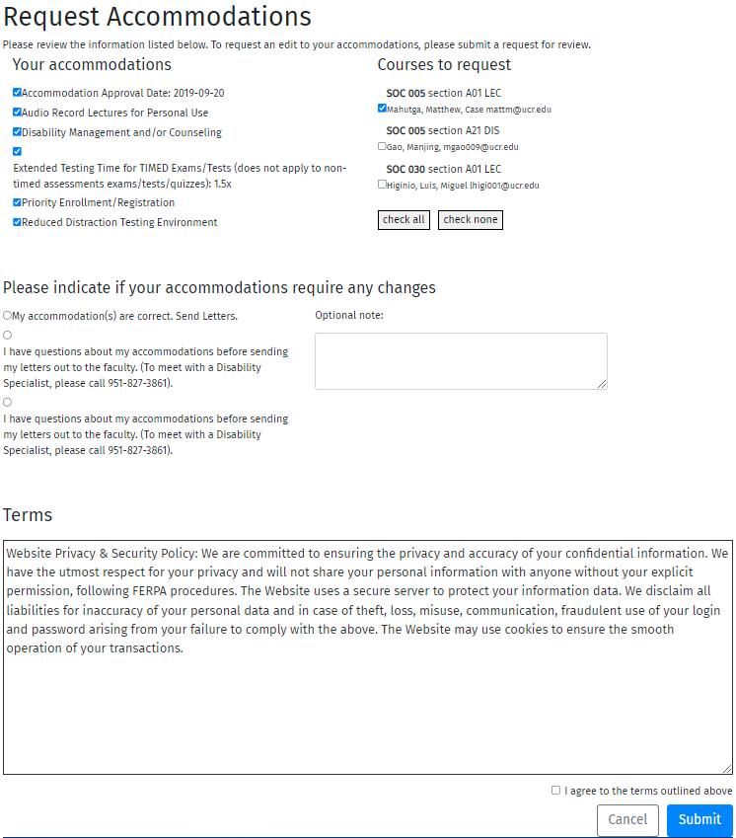
Request Accommodations
Select “Accommodations”
Select “Courses to Request”
Please indicate if your accommodations require any changes
Review the terms and select “I agree to the terms outlined above”
Select “Submit” to complete the request of accommodations process

Slide 8
Thank you!
For additional information, please contact us:
Email: sdrc@ucr.edu | Call: 951-827-3861
Visit: Student Services Building, Room 1228

