Slide 1
New student looking for services for temporary or permanent disabilities?
Online pre-registration

Slide 2
Online Pre-Registration

Slide 3
Welcome to R’Ability by Student Disability Resource Center (SDRC)
R’Ability is an online platform for SDRC
New Students Only: complete online pre-registration
It can be accessed 24 hours a day, 7 days a week
Website Support is available during regular business hours
Monday – Friday, 8am-5pm
Student Services Building, Room 1228
951-827-3061
sdrc@ucr.edu

Slide 4
R’Ability Website
Visit the R’Ability website at rability.ucr.edu
Select “Student Portal”

Slide 5
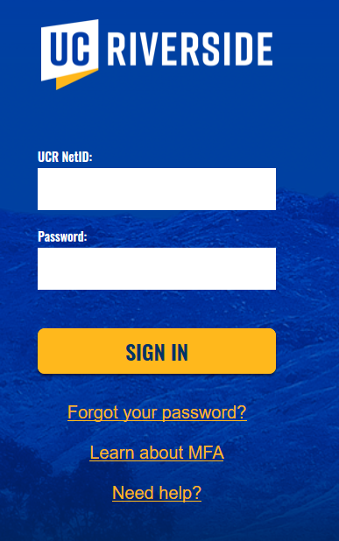
R’Ability Website
Login using the UCR credentials

Slide 6
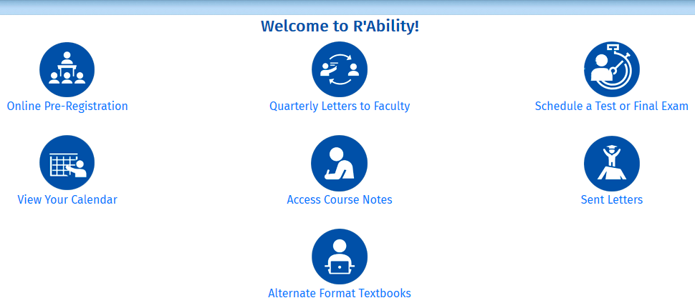
Welcome to R’Ability!
Select “Online Pre-Registration”

Slide 7
Online Pre-Registration Form
Complete the online pre-registration form
Contact information
Tell us some things about you (have you received accommodations previously, etc.)
Medical Information and Accommodations Requests

Slide 8
Documentation
Upload Disability Verification Documentation
UCR Forms completed by MD, Psychologist, Licensed Therapist, etc.
Neurological, Psychoeducational, Neuropsychological Reports
Other verification of disability forms or disability related documentation
If you do not have disability verification documentation, you can upload documentation that shows history of accommodations
Select “Submit” to turn in the online pre-registration form

Slide 9
What do I do after I submit the online pre-registration form?
You will receive a confirmation email
Schedule an intake appointment with a Disability Specialist
Visit https://sdrc.ucr.edu/apply-accommodations and select “Request an appointment” to submit the online appointment request form
OR
Call the SDRC 951-827-3861 to schedule an appointment

Slide 10
What happens next?
Student Responsibilities:
Attend the Intake Appointment with a Disability Specialist
Provide verification of disability consistent with UC Guidelines
Sign an Approved Accommodations Agreement to activate services
Request accommodations on a quarterly basis (some exceptions apply)

Slide 11
Thank you!
For additional information, please contact us:
Email: sdrc@ucr.edu | Call: 951-827-3861
Visit: Student Services Building, Room 1228

