Slide 1
Guide for Student eligible for Notetaking Services
How to request notetaking services
Accessing the notes

Slide 2
How to request notetaking services

Slide 3
R’Ability Website
Visit the R’Ability website at rability.ucr.edu
Select “Student Portal”

Slide 4
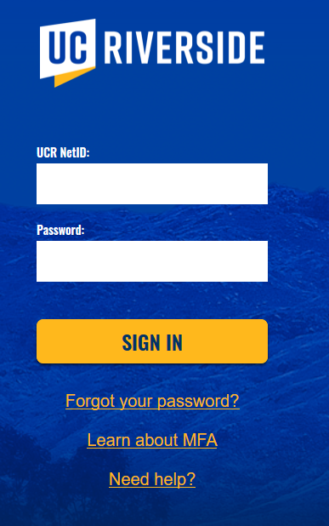
R’Ability Website
Login using the UCR credentials

Slide 5
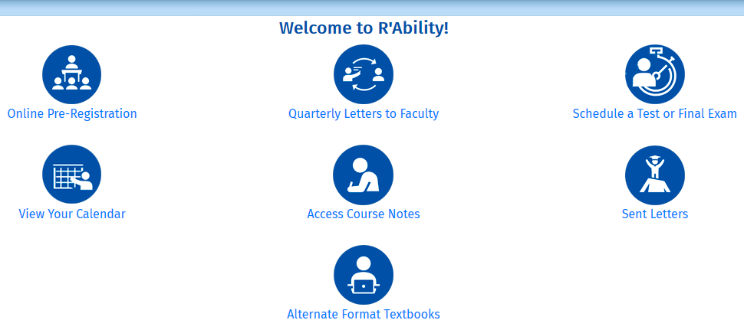
Welcome to R’Ability!
Select “Access Course Notes”

Slide 6
Courses/Notes
Select “Courses/Notes”

Slide 7
Courses
To confirm your note taker request was submitted, look in the second column “I require a note taker” and make sure it says “Yes.”

Slide 8
Note taker Availability
If a volunteer note taker signed up to share their notes, you will see that reflected under the “Note taker availability” column

Slide 9
Accessing Notes

Slide 10
R’Ability Website
Visit the R’Ability website at rability.ucr.edu
Select “Faculty Portal”

Slide 11
R’Ability Website
Login using the UCR credentials

Slide 12
Courses/Notes
Select “Courses/Notes”

Slide 13
Courses
Once notes have been uploaded, you will see them under the “My lecture notes” column

Slide 14
Thank you!
For additional information, please contact us:
Email: sdrc@ucr.edu | Call: 951-827-3861
Visit: Student Services Building, Room 1228

