Slide 1
Guide for Notetakers
Signing up process
Uploading notes

Slide 2
Signing up Process

Slide 3
R’Ability Website
Visit the R’Ability website at rability.ucr.edu
Select “Faculty Portal”

Slide 4
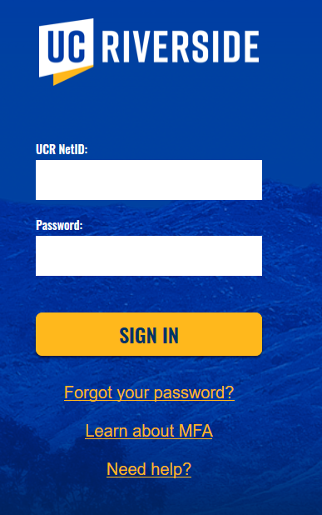
R’Ability Website
Login using the UCR credentials

Slide 5
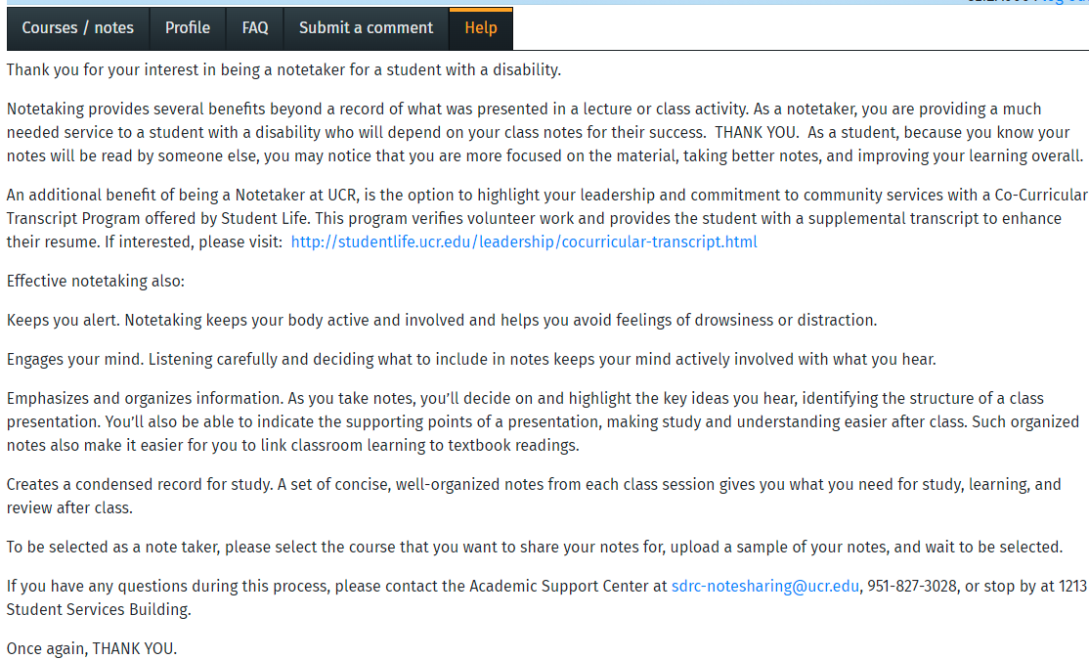
Courses/Notes
Select “Courses/Notes”

Slide 6
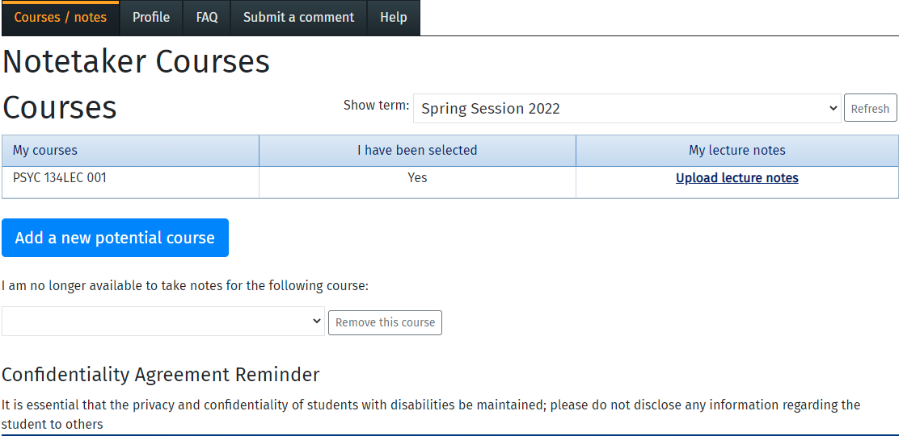
Notetaker Courses
The courses you are enrolled in will be listed. If you are selected to be a notetaker, you will see “Yes” under the “I have been selected” column.

Slide 7
Uploading Notes

Slide 8
R’Ability Website
Visit the R’Ability website at rability.ucr.edu
Select “Faculty Portal”

Slide 9
R’Ability Website
Login using the UCR credentials

Slide 10
Courses/Notes
Select “Courses/Notes”

Slide 11
Upload Lecture Notes
Select “Upload lecture notes” to begin uploading files for the SDRC student

Slide 12
Lecture Notes
Select “Upload a lecture note”
Instructor Name

Slide 13
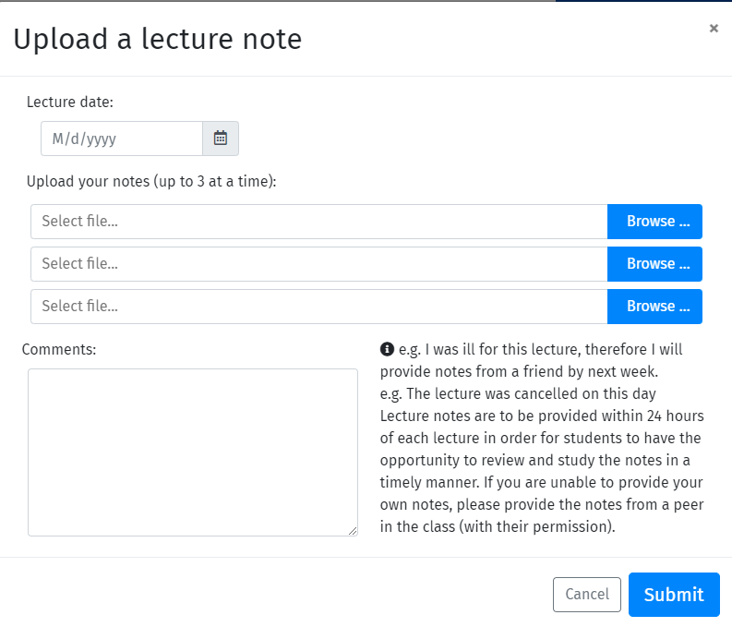
Upload a lecture note
Select “Lecture date” to match file being uploaded
Select “Browse” to search for your file
Submit “Comments” note if there is any information pertinent to the notes that you would like to share with the SDRC student
Select “Submit”

Slide 14
Additional Information
Please submit your notes/files per lecture date
If you have more than 3 files to upload per lecture date, submit a second submission for the same lecture date
If you have additional questions regarding the notetaking process please contact us via email at sdrc-notesharing@ucr.edu, via phone 951-827-3861 or in-person Student Services Building, Room 1213 (1st floor next to the elevator)

Slide 15
Thank you!
For additional information, please contact us:
Email: sdrc@ucr.edu | Call: 951-827-3861
Visit: Student Services Building, Room 1228

