Slide 1
Guide for Faculty Navigating R’Ability

Slide 2
R’Ability Website
Visit the R’Ability website at rability.ucr.edu
Select “Faculty Portal”

Slide 3
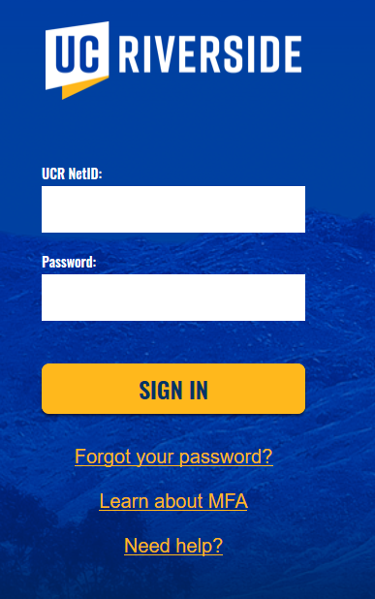
R’Ability Website
Login using the UCR credentials

Slide 4
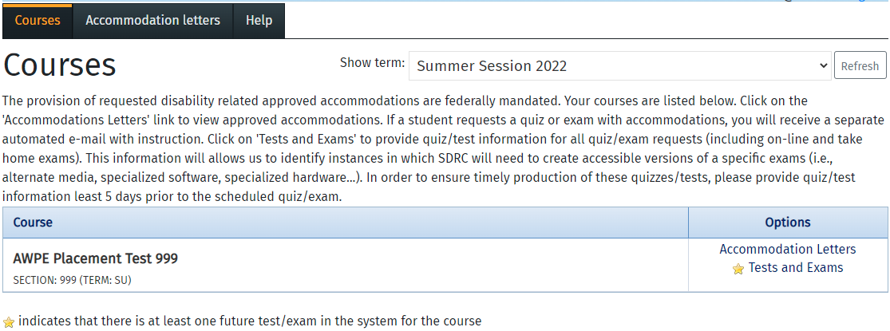
R’Ability Website
Select “Courses”

Slide 5
Tests and Exams
Select “Tests and Exams” under Options

Slide 6
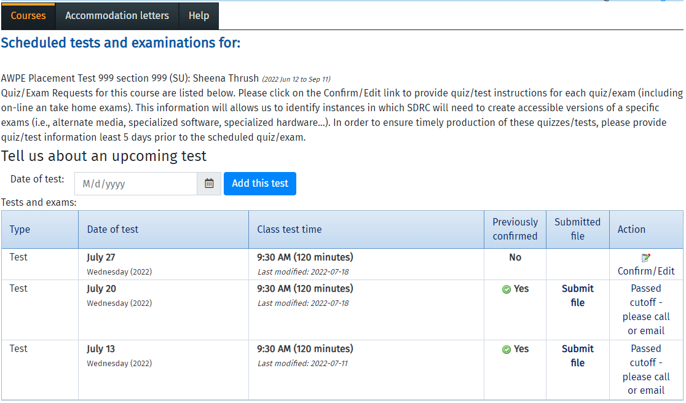
Tell us about an upcoming test
Enter Date of Test
Select “Add this Test”

Slide 7
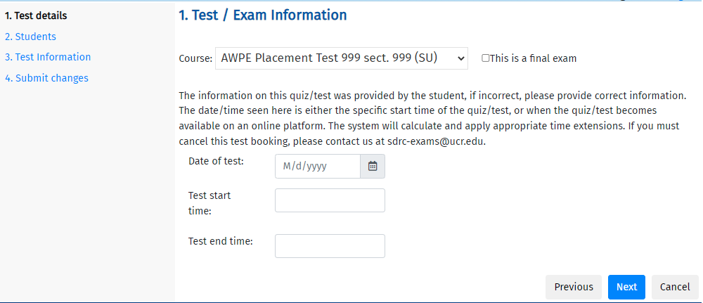
Test/Exam Information
Enter the Date of Test, Test Start Time and Test End Time
Select “Next”

Slide 8
Students scheduled to date for CLASS NAME
Review the list of the students that have registered to take the quiz / test. You may or may not see a list of students; this will depend if the student has informed SDRC that they plan to take the exam with testing accommodations.
Select “Next”
Student Name (Student ID)

Slide 9
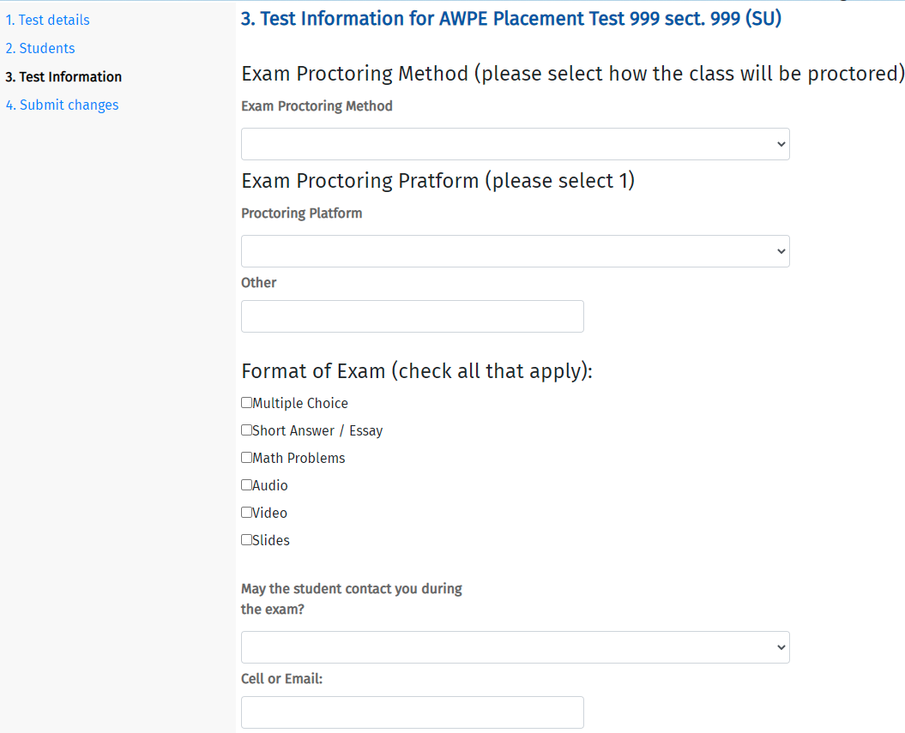
3. Test Information for CLASS NAME
Enter the Exam Proctoring Information
Continued…

Slide 10
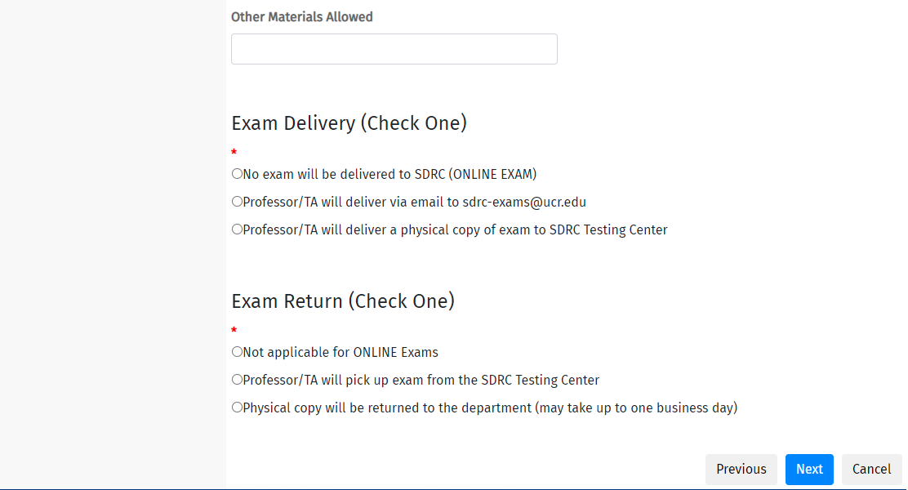
3. Test Information for CLASS NAME
Enter the Exam Proctoring Information
Continued…

Slide 11
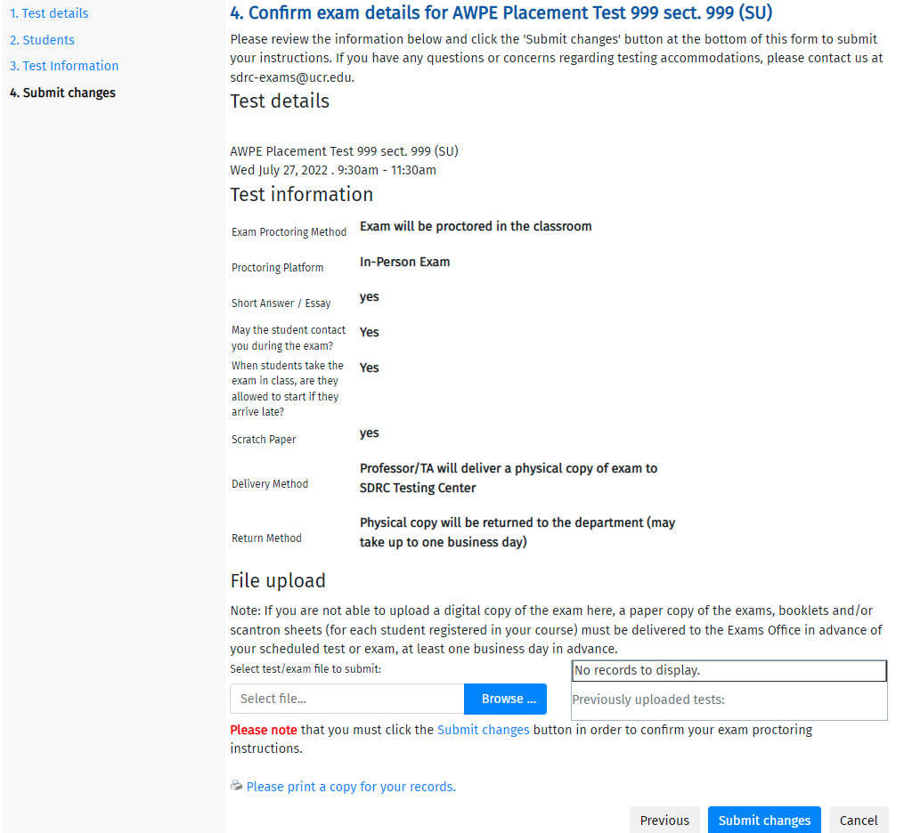
4. Confirm exam details for CLASS NAME
Review the Test Details and Test Information
Select “Submit Changes” to complete this process

Slide 12
Thank you!
For additional information, please contact us:
Email: sdrc@ucr.edu | Call: 951-827-3861
Visit: Student Services Building, Room 1228

