Slide 1
R’Ability Guide for Students: Training on View Your Calendar

Slide 2
Steps to View Your Calendar on R’Ability

Slide 3
R’Ability Website
Visit the R’Ability website at rability.ucr.edu
Select “Students Portal”

Slide 4
R’Ability: View Your Calendar
Select “View Your Calendar”

Slide 5
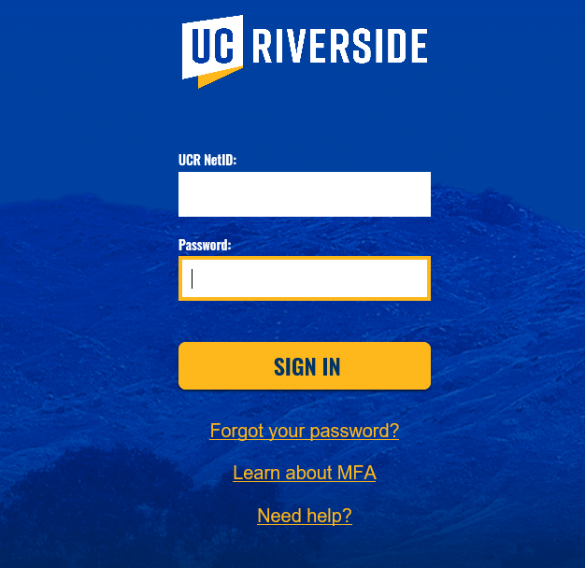
Login Screen
Log in using your NetID and password

Slide 6
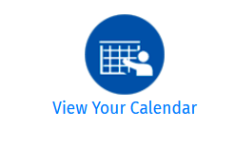
R’Ability: View Your Calendar
View Scheduled appointments with a Disability Specialist
View scheduled quizzes, tests, or midterms
View scheduled Final Exams

Slide 7
R’Ability: View Your Calendar
View upcoming scheduled exams, quizzes, Midterms with Accommodations, Final Exam and appointments

Slide 8
R’Ability: View Your Calendar
If you do NOT have any upcoming scheduled appointment, tests, or exams, no events will be displayed under “My Upcoming Events”

Slide 9
Thank you!
For additional information, please contact us:
Email: sdrc@ucr.edu | Call: 951-827-3861
Visit: Student Services Building, Room 1228

